Slide 1
Category review: Chips
June 2020
Retail Strategy & Analytics
Brand note: If client logo is not required, use alternate title page layout right click slide thumbnail > Layout > Title

Slide 2
Notes:
To view Privacy video explaining how important data privacy is to Quantium, please click here: https://www.youtube.com/watch?v=Zq1QDAkoRzU
or here Q:\Company Reference\Brand & Design\Brand videos\Q Privacy.mp4
At Quantium, we believe that data is the behavioural footprint of humanity and that it has to be treated with the utmost care and responsibility.
Histories, attitudes, indeed lives are stored within it in ways that aren’t always apparent – and that’s what makes its potential so powerful.
To work with it responsibly, sensitively, we set ourselves the highest data privacy protection and governance standards.
We have spent 17 years perfecting privacy-by-design and secure-by-design principles. Central to this is not holding any personally identifiable information about people –
we neither receive it, and put the necessary protections in place to be unable to decipher it.
Every aspect of handling data is safeguarded: from its de-identification, to its encryption – data security is paramount and of the highest grade.
We pride ourselves on gaining the trust of iconic organisations around the world through years of securely working with their data,
and in turn the trust that builds with their stakeholders.

Slide 3
Table of Contents
Problem Statement and Purpose
Methodology
Executive summary
Overview and Context
Key Findings and Insights
Recommendations and Next Steps
Summary

Slide 4
Problem Statement and Purpose
Problem statement: The Category Manager for Chips wants to better understand the types of customers who purchase Chips and their purchasing behaviour within the region.
Purpose: The insights from the analysis will feed into the supermarket’s strategic plan for the chip category in the next half year.

Slide 5
Methodology
The methodology used for the analysis involved examining the transaction dataset provided by the client to identify customer purchasing behaviours. This was done to generate insights and provide commercial recommendations to the client. Additionally, benchmark stores were identified to test the impact of trial store layouts on customer sales. The techniques used for the analysis included data cleaning and manipulation, data visualization, statistical testing, and hypothesis testing. The data sources used were transaction and customers data provided by the Category Manager of chips.

Slide 6
Executive summary
Chips sales increase before Christmas, presenting an opportunity for promotional offers.
Mainstream young singles/couples and midage single/couples customers are willing to pay more for chips, while premium shoppers are less likely to buy chips.
Budget older families, Mainstream young singles/couples, and Mainstream retirees are the main chip buyers.
01
Chips Category Review
02
Trial Store Analysis
A control store was constructed to reflect the prior performance of the selected trial store.
After implementing the new store layout the performance of the trial store and the control store were compared. The trial store saw significant uplift from the new store layout.

Slide 7
Overview and Context
The Quantium Retail and Analytics Project aims to leverage transactional and customer data from a data partnership with a large supermarket brand to deliver valuable data analytics and insights. As an analyst within the Quantium analytics team, the goal is to provide strategic recommendations and support decision-making processes within the supermarket business. This project focuses on evaluating and analyzing the performance of changes made in store layouts implemented by the supermarket brand, its Impact on Customer Behaviours and provide insights and recommendations to optimize store layouts for better results.

Slide 8
01
Category

Slide 9
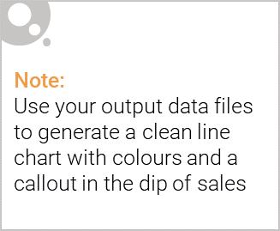
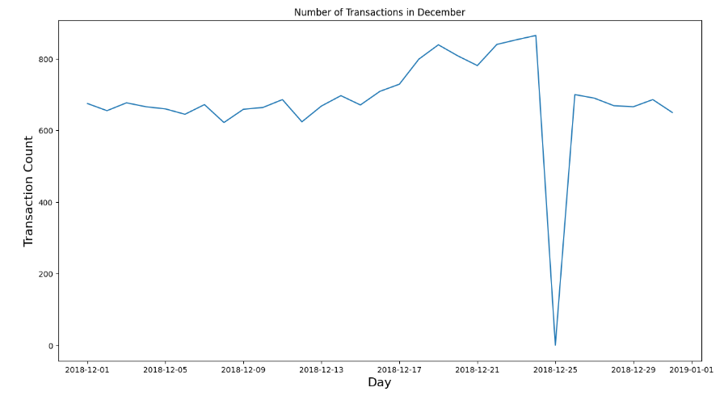
We can see that the increase in sales occurs in the lead-up to Christmas and that there are zero sales on Christmas day itself. This is due to shops being closed on Christmas day.

Slide 10

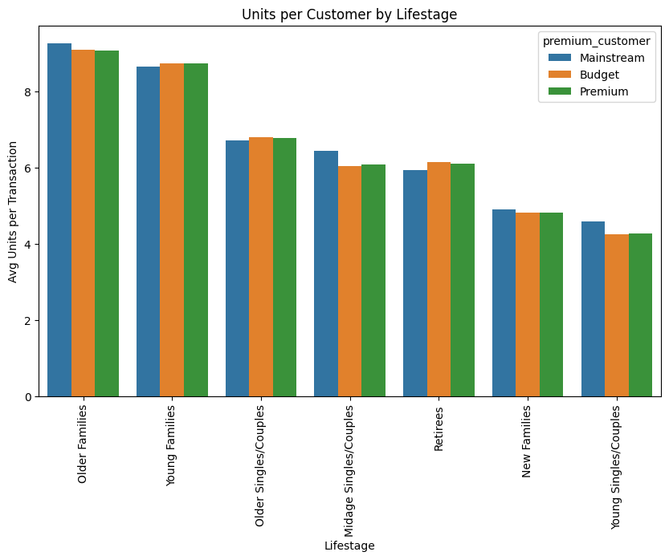
Older and Young Family shoppers purchase the highest avg units per transaction. This contributes to, there being more sales to these customer segments but this is not a major driver for the Budget - Young Single/Couples.

Slide 11
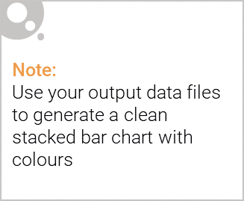
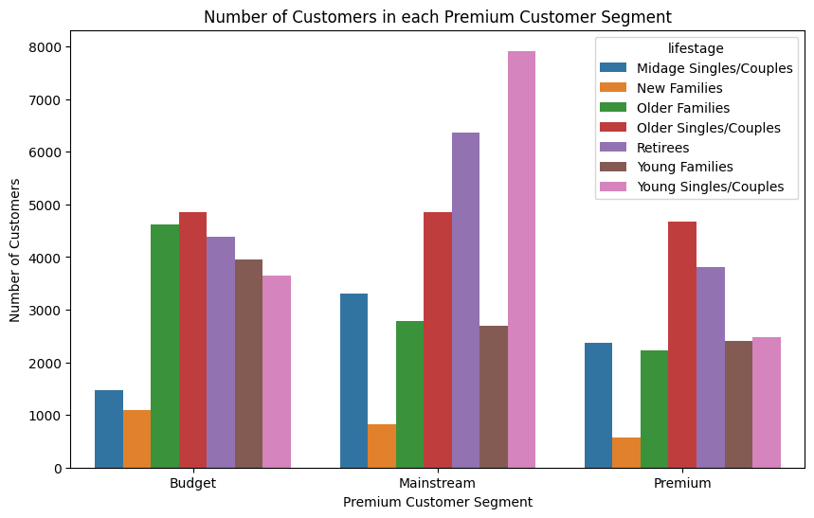
Editable (delete this)
Sales are coming mainly from Budget - older families, Mainstream - young singles/couples, and Mainstream – retirees. It could be useful for the Category Manager to focus their marketing and promotional efforts on these segments to drive further growth and increase market share.

Slide 12
Key Findings and Insights
Through our analysis, we identified several key findings and insights, including:
Mainstream - young singles/couples are 23% more likely to purchase Tyrrells chips compared to the rest of the population.
Mainstream - young singles/couples are 56% less likely to purchase Burger Rings compared to the rest of the population.
Mainstream - young singles/couples are 27% more likely to purchase a 270g pack of chips compared to the rest of the population but let's dive into what brands sell this pack size.
Larger pack size of 270g is only offered by Twisties, which may explain why the target segment has a higher affinity towards this pack size. This could indicate a higher likelihood of the target segment purchasing Twisties over other brands.
Findings suggest that there are distinct segment differences in chip purchasing behaviour, including brand preference, pack size preference, and willingness to pay more for chips.

Slide 13
02
Trial store performance

Slide 14
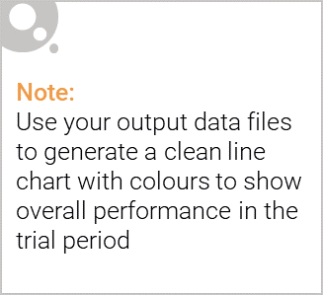
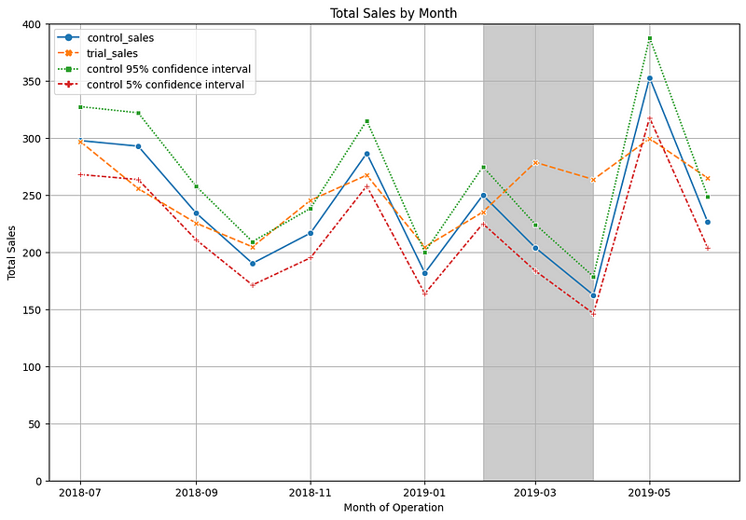
The control store is constructed to reflect performance of the trial store
rather than the average of other stores

Slide 15
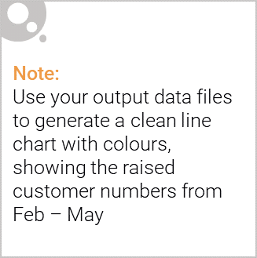
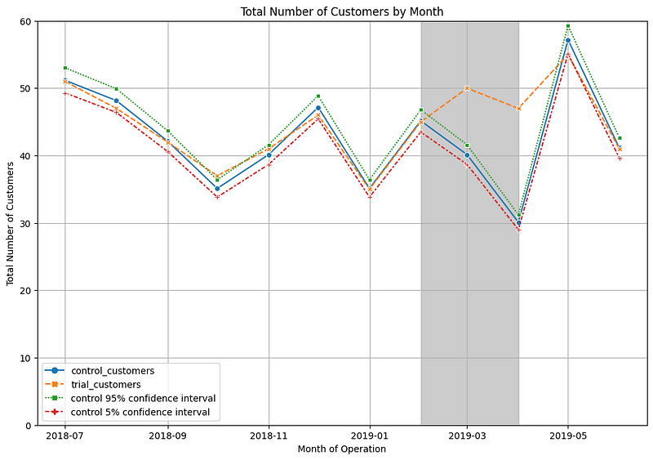
From Feb to May the trial store outperformed the control store highlighting
the success of the new store layout

Slide 16
Key Findings and Insights
Through our analysis, we identified several key findings and insights, including:
The trial in store 77 is significantly different to its control store 233 in the trial period as the trial store performance lies outside the 5% to 95% confidence interval of the control store in two of the three trial months.
The trial in store 86 is not significantly different to its control store in the trial period as the trial store performance lies inside the 5% to 95% confidence interval of the control store in two of the three trial months.
Number of customers is significantly higher in all of the three months. This seems to suggest that the trial had a significant impact on increasing the number of customers in trial store 86 but as we saw, sales were not significantly higher.
The trial in store 88 is significantly different to its control store in the trial period as the trial store performance lies outside of the 5% to 95% confidence interval of the control store in two of the three trial months.
Total number of customers in the trial period for the trial store is significantly higher than the control store for two out of three months, which indicates a positive trial effect

Slide 17
Summary
At a high level I have found that:
Mainstream Young Singles & Couples remain the primary shoppers of chips
Opportunities have been identified with Young and Older Families
Trial store performance was increased as a result of the new store layout

